Slide 1
PROTOTYPE OF FOOD QUALITY DETECTION AND DOCK MANAGEMENT SYSTEM
Team Brown –
A.B.KAMALESH (TL) | BHAVYASREE B | DARSHAN
NEELURU BHAVANA | PRIYANKA J

Slide 2
AGENDA
WORKING OF FOOD QUALITY DETECTION
WORKING OF DOCK MANAGEMENT SYSTEM

Slide 3
DOCK MANAGEMENT SYSTEM
Objective of the prototype is to ensure safety and security in dock using Object Detection mechanism
Main focus was on ensuring safety when the vehicle is being reversed
The obstructions between the vehicle and the dock are to be detected and a safety signal in the form of an alarm or SMS to concerned authorities
The movement of authorized vehicle inside and outside the dock is also to be detected

Slide 4
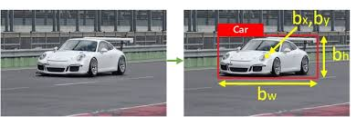
WORKING
YOLO OBJECT DETECTION
In Object Detection Algorithms are basically used for scanning and searching for object in video or image.
Basically the algorithms are trained on a dataset which consists of input image with the labels to be predicted as bounding boxes around the objects
Bounding boxes, as the name suggests, are the means through which the objects in the image are categorised i.e. we try to enclose the detected object inside a bounding box

Slide 5
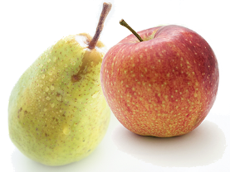
WORKING
So each image (or frame) is resized into a particular size
The bottom right corner is considered as the origin
The coordinates of each bounding box are given as x and y coordinates of top left corner of the box followed by width and height of the box
But, since two objects having similar bonding boxes, for example an apple and pear, to distinguish between them we use Anchor Boxes

Slide 6
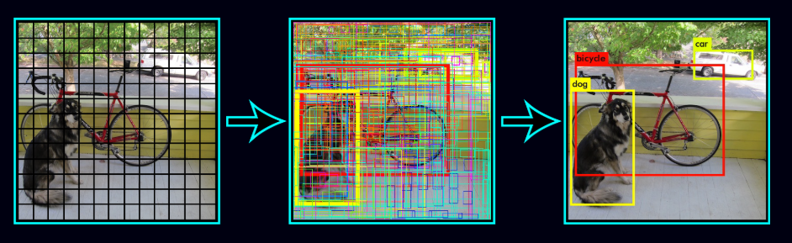
WORKING
So, we create a number of anchor boxes associated with each label
Each Anchor box will decide which bounding box will have highest overlap by non-overlap, this concept is called Intersection Over Union (IoU)
We set a threshold(confidence measure) i.e. if the IoU is over 50%, the algorithm should detect the object that gave highest IoU
While training we also set a lower limit, if IoU is less than that limit then the detected object is ambiguous and hence cannot be learned

Slide 7
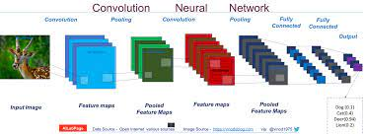
WORKING
CONVOLUTION NEURAL NETWORK
For a classifier, the detector requires the following
Higher input network for detecting multiple small sized objects
More layers, to cover increased size of input
More parameters, for greater capacity to detect variety of multiple objects from single image
YOLO v4 uses CSPDarknet53 architecture which contains 29 3 x 3 convolution layers, 725 x 725 receptive field, and 27.6 Million parameters

Slide 8
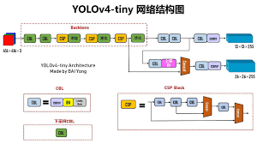
WORKING
KEY FEATURES OF YOLO V4
Uses:
Bag of Freebies (BoF)
Bag of Specials (BoS)
Consists of :
Backbone: CSPDarknet53
Neck: SPP and PAN
Head: YOLO v3

Slide 9
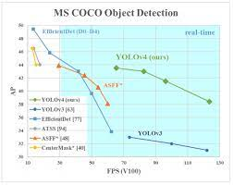
WORKING
In our project we use the concept of Transfer Learning, in which we use pre-trained model as a starting point to a related problem
We use pre-trained weights of YOLO v4 tiny trained on COCO dataset for image classification and PASCAL VOC dataset for object detection
The configuration and weights files are about 20 MB which makes YOLO v4 tiny faster in detection i.e. a speed of processing a frame in 0.2 seconds

Slide 10

WORKING
OpenCV Object Tracking
OpenCV is a Open Source Computer Vision Library that provides tools and hardware for real time computer vision applications
Object tracking is the process of taking an initial set of detections, creating an unique ID for each detection and then tracking them as they move around in frames.
The logic used in our project is that of Centroid Tracker.
It accepts bounding boxes and computes centroids from the initial round
The in further rounds, it computes Euclidean distances between new bounding boxes and existing objects and update their coordinates accordingly

Slide 11
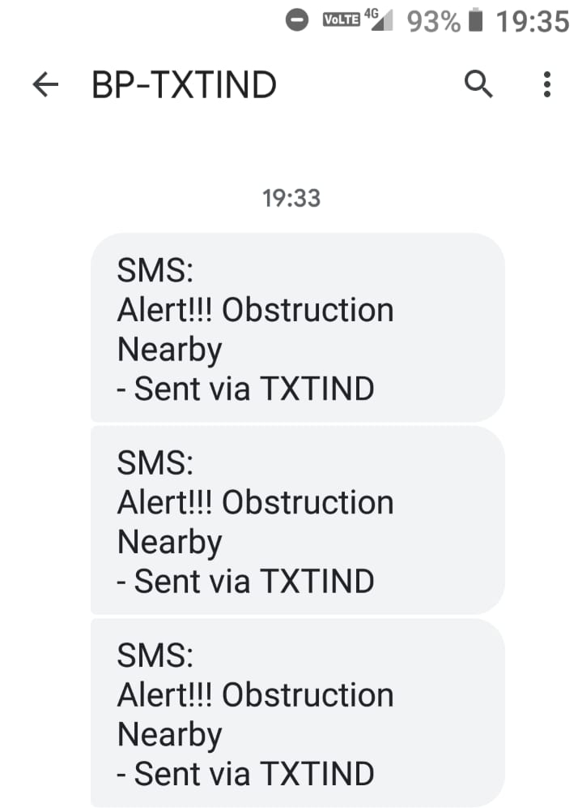
WORKING
Alert
We created an account in FAST2SMS webpage.
Using the Authentication key and User ID given by the website, we write a python function
The function will post a JSON request to send a given message to concerned authorities
The mobile numbers of the authorities are passed as parameters via dictionary

Slide 12
WORKFLOW
Take input stream of video
Detect object and assign unique id
Detect a truck and calculate its distance from other objects in image
Use a distance metric to alert
Similarly, use object tracking to track incoming or outgoing vehicle
Predict the direction

Slide 13
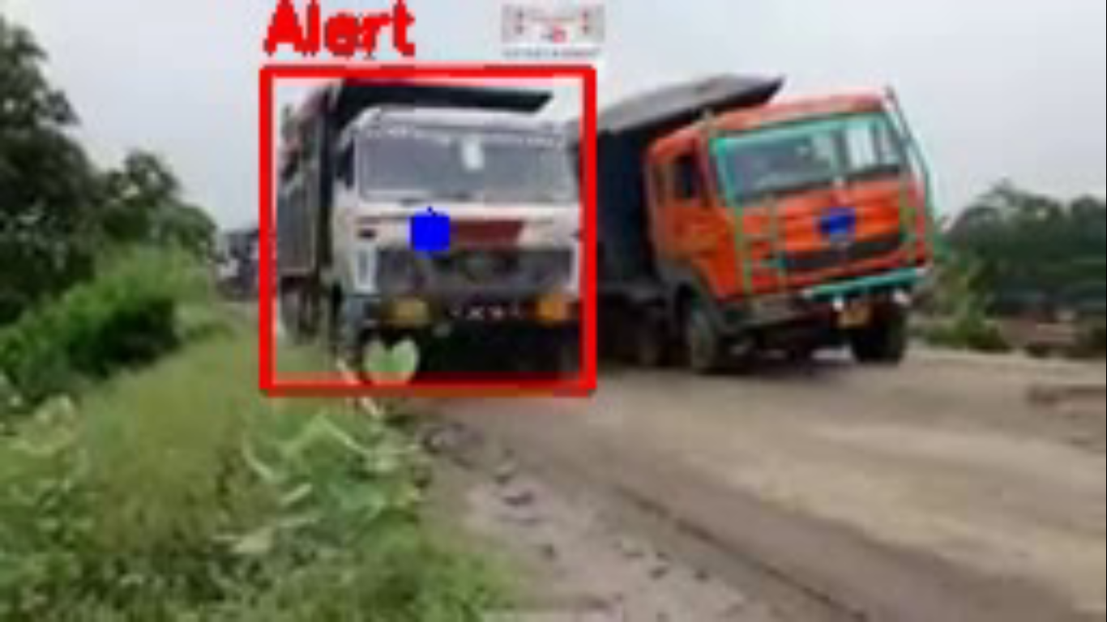
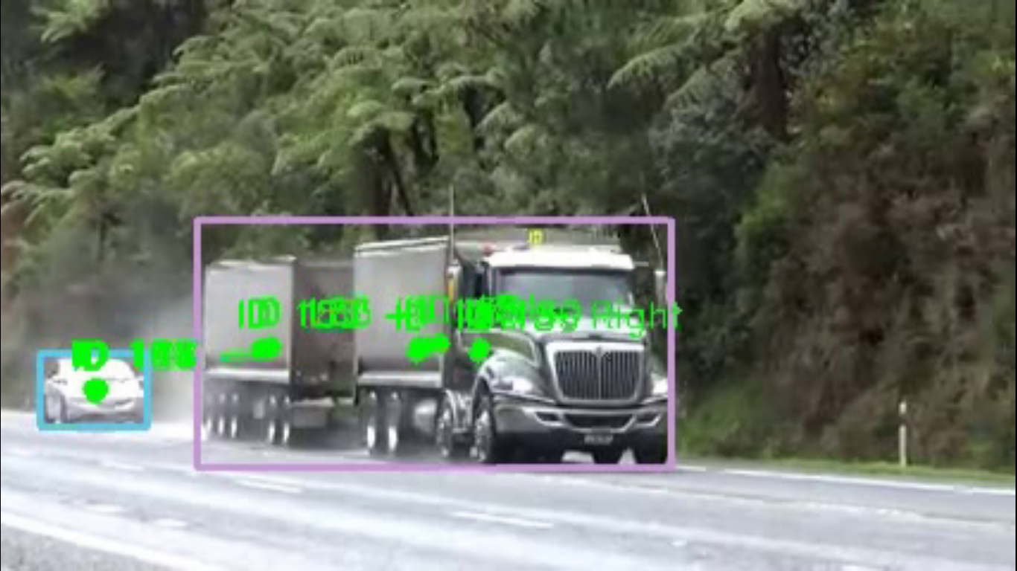
RESULTS
Alert Message
Object Detection
Object tracking

Slide 14
FOOD QUALITY DETECTION USING IOT
SUBMITTED BY:
TEAM BROWN
A.B.KAMALESH B.
BHAVYASREE
DARSHAN KUMAR
NEELURU BHAVANA
PRIYANKA J

Slide 15
OBJECTIVE:
The objective is to deliver fresh products to the customers.
To achieve this, we have to constantly monitor the quality of the products.
In this IoT project, we have designed a Food Monitoring device using Arduino Mega and connected the data through the Blynk app, to monitor the quality of the food and send alerts if the food is found degrading.
To determine the status of the food, the MQ4, MQ135 gas sensor modules, and DHT11 module are used

Slide 16
COMPONENTS USED:
HARDWARE USED:
Breadboard and Jumperwires
MQ4 Gas grove sensor
MQ135 Gas sensor
DHT11 Temperature and Humidity Sensor
Micro SD Card
Micro SD Card Module
ESP8266-01 WIFI Module
ARDUINO MEGA 2560 REV3

Slide 17
SOFTWARE USED:
Blynk app
Arduino IDE

Slide 18
DESIGN AND WIRING:
Design of our prototype:
The prototype is designed on an Arduino Mega 2560 Board.
ESP8266-01 Wi-Fi module is connected to the board through Serial1 pins- 19(RX1)/18(TX1) to provide internet connectivity.
The gas sensors MQ4 and MQ135 are connected to the 5 Volt supply of the external breadboard for power.
The Micro-SD card module is also powered through the external breadboard for power.

Slide 19
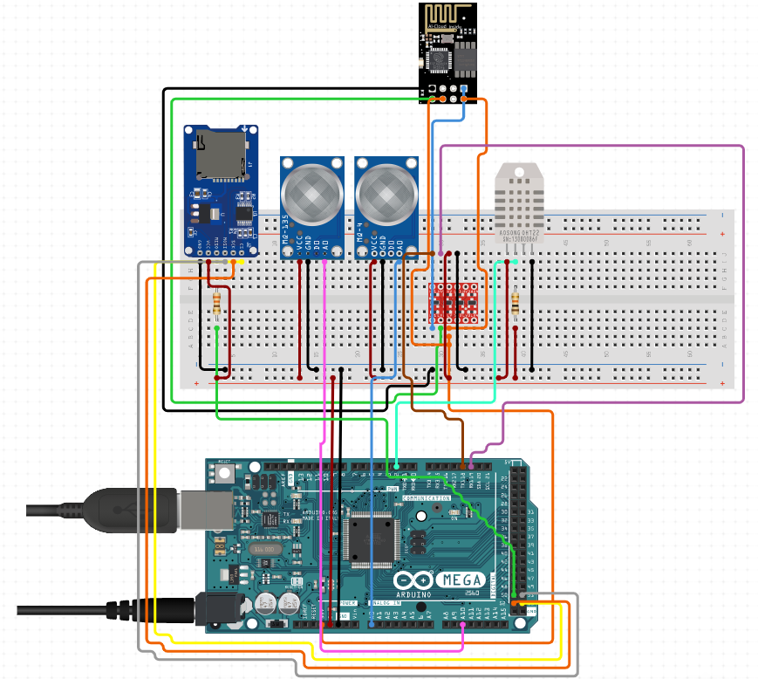
WIRING:

Slide 20
ADVANTAGES OF OUR MODEL:
Smart gas detection system.
Mq135 has high sensitivity towards ammonia, sulfide, benzene, alcohol, SMOKE, CO2.
MQ-4 can detect high concentrations of methane.
Pollutant monitoring system: as major pollutants are sulfides; nitrogenous compounds thus can be guessed by Mq135.
Fire detection system: smoke in the air can be detected by mq135.
Toxic gas detection: the presence of poisonous gases in a warehouse can contaminate edible products, and is harmful to the workers being employed there. MQ135 can primarily detect smoke.
MQ4 can detect methane from a range [300,10000] ppm.

Slide 21
Our prototype can successfully operate from -10 to 50C, without any lagging.
Smart alarm system: It is programmed to show the measured values of the gases in ppm, with color labels showing the level (safe, normal, dangerous).
The above alarming system will help even the illiterate workers, to understand the warning, and take necessary action.
The variations in the readings, in shown live with a gauge widget, with fast- flexible animations.
The data are stored in an SD card, which acts as an offline database, and keeps storing data, irrespective of internet connection.
The data stored in an SD card can be used for data analysis, investigation, in case of any fire accident., etc.
It provides REAL-TIME MONITORING, of a warehouse.
Provides remote accessibility, alarm system.

Slide 22
DISADVANTAGES OF OUR MODEL
The front-end role of the BLYNK APP brings some limitations.
The data analysis cannot be done by the Blynk app (it is out of scope for Blynk)
It has limited free widgets.
Once data is pushed to virtual terminals of Blynk Server, we cannot retrieve it back, thus the data is wasted, just for showing animations in widgets.
The internet speed requirements of Blynk are high, which limits its usage, in remote areas.
The data stored in SD card, is the ONLY WAY, to do data analysis, and thus DATA ANALYSIS cannot be done in parallel when the device is working (as read, write cannot be done at the same time, in SD card, when the device is working, data will be continuously written in SD card).
There is no scope of showing analysis of data, in the Blynk app, as no such widget is available.
The number of users accessing the same project using Blynk is limited.

Slide 23
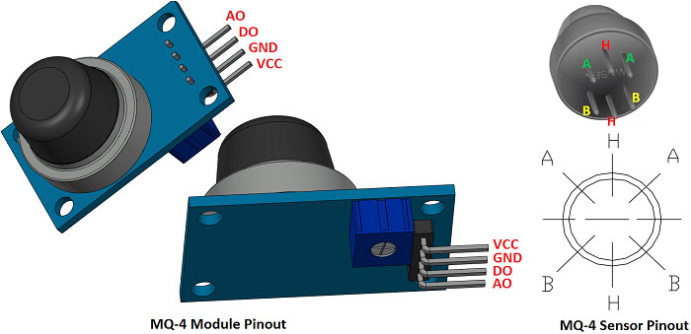
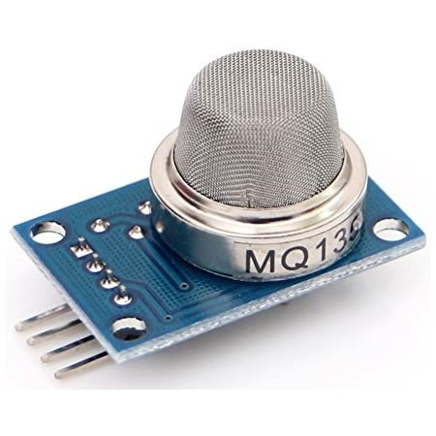
DETAILED EXPLANATION OF WORKING PROCESS:
ROLE OF GAS SENSOR (MQ4 & MQ135)
The internal resistance of the sensor changes when exposed to a rotten or overripe sample. The change is proportional to the concentration of methane produced by the sample.
Accordingly, the raw data also changes. This can be taken as analog output and converted to the corresponding voltage value.
This in turn is converted to ppm through the calibration process.

Slide 24
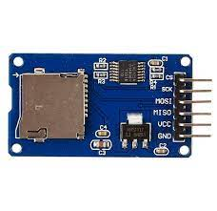
ROLE OF SD CARD:
It acts as an offline Database, to store the sensor data.
Its role is crucial, in investigations, to any fire accident, which may hamper, internet access to the hardware.
The data stored can be reliably used for “Data analysis”, to understand the
dynamics of the warehouse.
It is timely formatted, through the code, and its data entries are time stamped, to increase the uniqueness, of each reading.

Slide 25
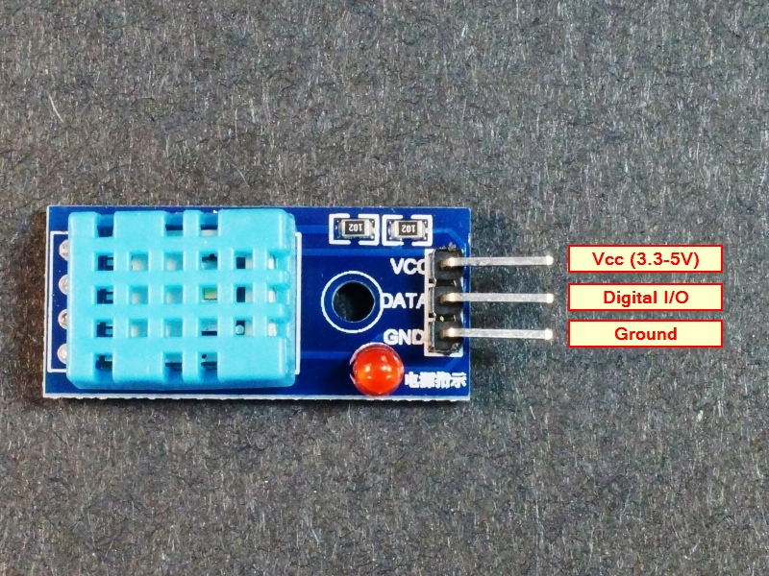
ROLE OF DHT-11 TEMPERATURE-MOISTURE SENSOR
The temperature sensor uses a thermistor of NTC (negative temperature coefficient) type (resistance decreases with increase in temperature).
Thermistors are resistors, which are highly sensitive to temperature change.
The science behind moisture sensor, can be understood from this diagram:
Higher relative humidity decreases resistance, between electrodes, and the vice-versa in case of lower relative humidity.

Slide 26
IOT INTEGRATION (ROLE OF PROGRAMMED HARDWARE) :
ESP8266 WIFI Module implements the IP Layer of the OSI stack and has a NIC (network interface card) implemented in its hardware. It links the board to the internet.
Arduino board is pushed with a code, that is responsible to start a dedicated connection to BLYNK SERVER.
The frequency at which, data will be transmitted to the server, is decided by the timers, set through code.
The hardware code programs the board to store data into an SD card, and in case an internet connection is available, then it should create a dedicated connection to the Blynk server.
Each sensor data will be written in which the pin while sending data to the server, is decided by the programmer.
The program is also responsible for receiving data from the server (in case the remote user, pushed data to a pin).
Exception Handling, must be done, to catch and sort out the errors.
The color, label of Blynk widgets, can be controlled through code.

Slide 27
IOT INTEGRATION (ROLE OF BLYNK SERVER)
ESP8266 regularly checks for available internet connection.
When connected to the internet, it starts sending the sensor readings, to the BLYNK server, in dedicated virtual pins.
The app with the user needs not to be online (connected with the internet).
When a remote user connects the Blynk app to the internet, his IP address is sent to the Blynk server, along with the unique “project authentication token”.
When the hardware (Arduino) sends data to the Blynk server, it uses the same
unique “project authentication code”.
Blynk server, after receiving the data, from Arduino hardware, checks if any remote online user, is opening a project, with the same “project authentication code”. In that case, it starts sending, the live data, after creating a secure HTTP connection.
In case no remote user is available, the server, simply drops the data, without returning any error.

Slide 28
FRONT END WITH BLYNK:
Blynk provides several free widgets, to display sensor data.
Each project created has a unique “project authentication code”.
Each project provides access to manipulate/read a limited number of pins.
The category of pins in Blynk projects includes analog, digital, virtual.
Each widget, while its induction into the project, is assigned a pin/(pins).
A typical widget can read the data from an assigned pin, and display it, based on the accuracy decided by the app settings, with animations.
Widgets with the ability to push data, into pins, also exist, for example a switch widget, with 2 states as: - ON, OFF.

Slide 29
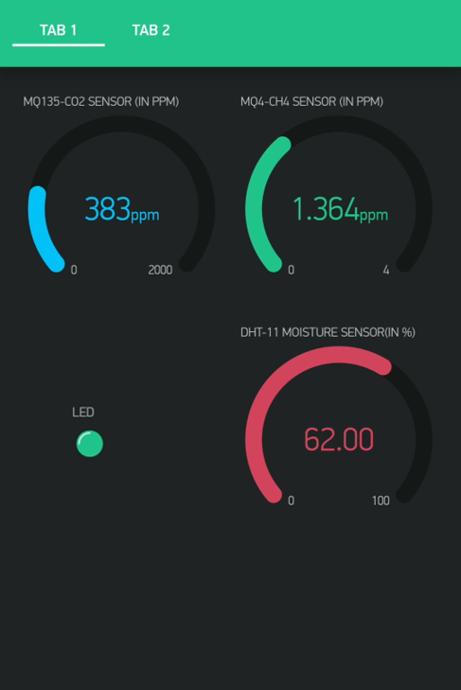
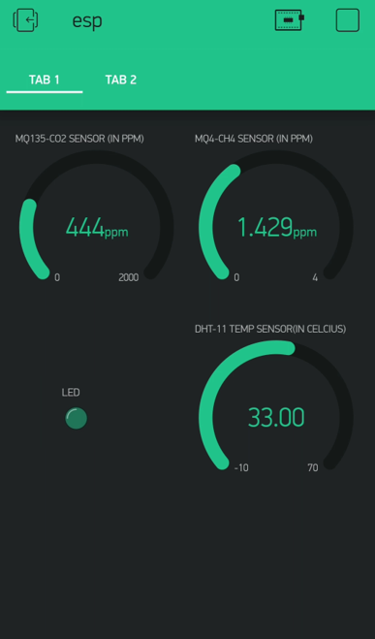
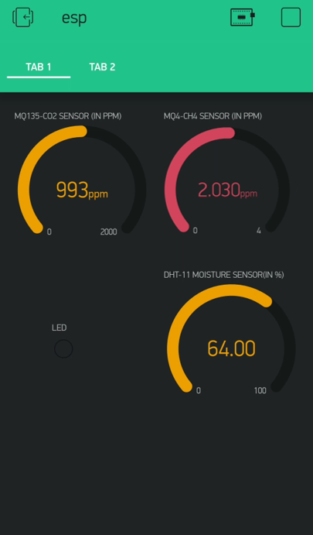
PROTOTYPE PICTURES:

Slide 30
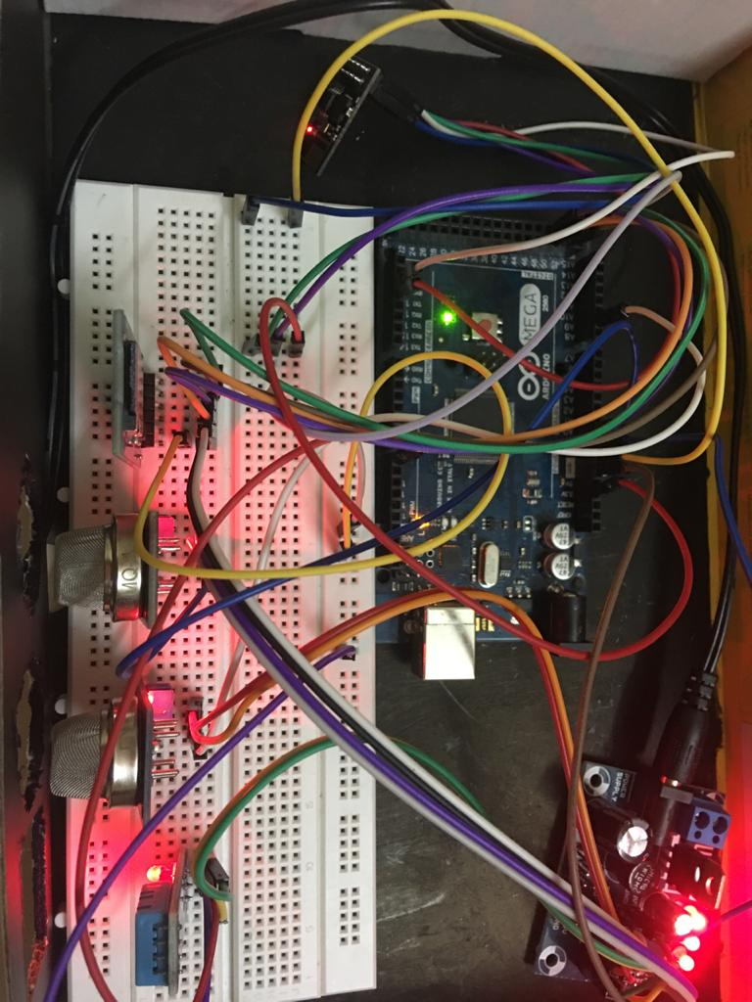

Slide 31
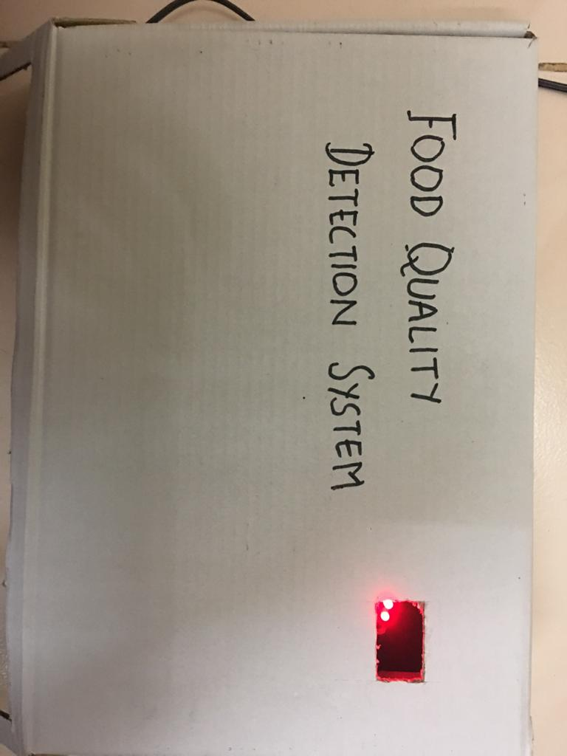
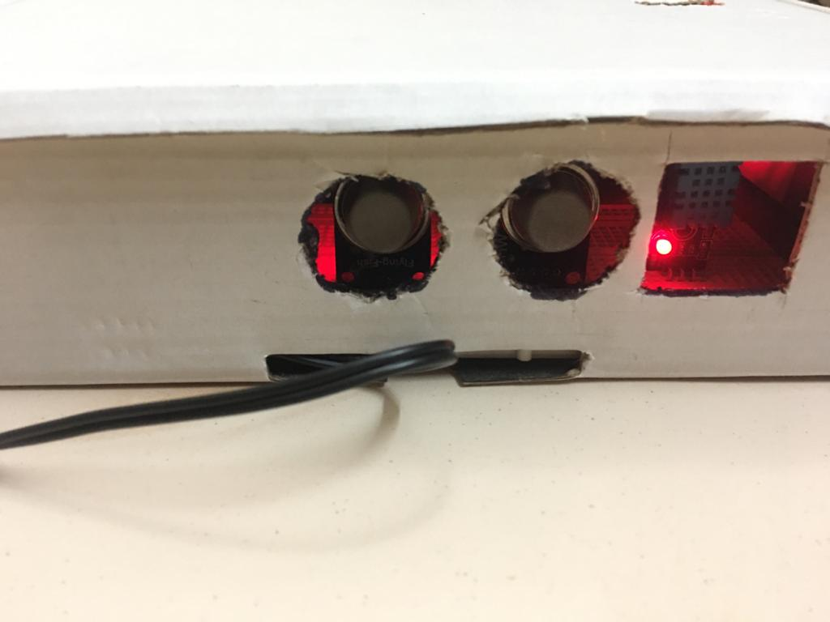
External casing pictures

Slide 32
FUTURE POSSIBILITIES WITH OUR PROTOTYPE:
It can be integrated with SMART ENERGY GRID, to provide, round a clock power supply, and save appliances, from voltage variation.
It can be integrated with SMART ROBOTIC LOADING-UNLOADING.
It can be integrated with a SMART AIR FILTRATION system, which provides filtration based on the pollutant detected by the sensor.
The IoT setup can be extended to track the vehicles, carrying the load for the cold storage, and it can give an alert to workers, to keep the warehouse ready, to receive new inputs.
Additional sensors to detect the moisture in the air can be integrated into the prototype, to provide a complete solution to preserve/protect edibles being stored.

Slide 33
To overcome the limitations of Blynk, the other free alternatives should be looked at. A suggestion will be to use the “telegram app bot”, because of its robust, powerful, super-easy API.
Elaborating on the above point, “/game” can be used on telegram, which provides the developer to run an HTML-5 interactive environment, which can be used to show data, visualize data, and thus achieve what Blynk does.
Only the users, currently meant to receive sensor data, can be included in a private group, where the bot is a member.
Full control remains with the administrator, and security features of the market best, can obviously, can't be questioned.

Slide 34
CONCLUSION
The aim of this project is to create a Food Quality Detection system. IoT devices have become one of the most upbeat trends present and more the IoT devices used, more automation, and better control over objects. IoT has helped in providing more new concepts which result in making our surroundings smarter.
Our prototype can detect rotting and decay using input from various sensors like MQ4, MQ135, and DHT 11. The micro-SD card provides backup for data in case of a power failure. The entire setup is connected to the internet and the data is sent to the Blynk server for analysis.
The real-life implementation may be challenging and difficult but it may yield optimal results.

Slide 35

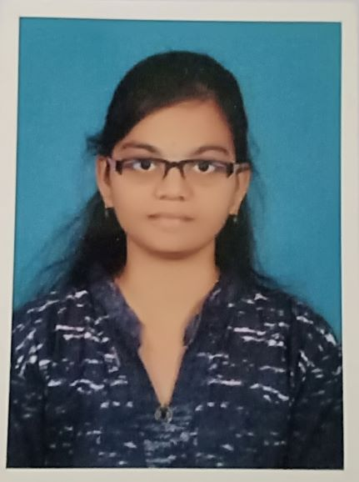


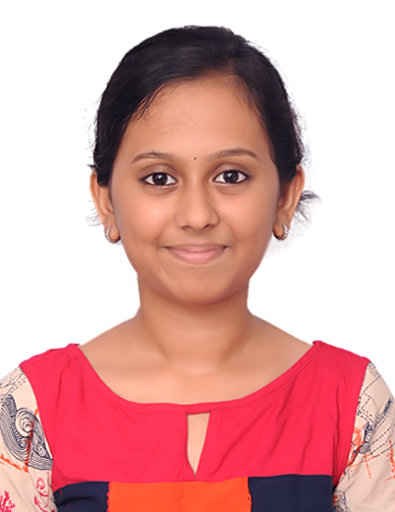
TEAM MEMBERS
A.B.Kamalesh (TL)
Neeluru Bhavana
Bhavyashree
Darshan Kumar
Priyanka J

Slide 36
THANK YOU

